Slide 1
Software Testing Methodologies
Prashant Joshi

Slide 2
The Concept
A black box test technique
Based on specifications
Independent of implementation
Focus
Functional testing
Behaviour
Input & corresponding output
x
P
(Square
of number)
x²
Implementation may be,
Multiplication (x*x)
successive addition (x+x… x times)

Slide 3
Perspectives
Customer/Client
Alpha/Beta User
End User/Consumer
Development Engineer
Architect
Product Manager
Maintenance Engineer
…

Slide 4
Equivalence Class
Equivalence Classes (EC)
EC forms a partition of a set (input domain), where partition refers to a collection of mutually disjoint subsets (subdomains) when the union is an entire set
Two important implications
The fact that the entire set is represented provides a form of completeness
The disjointedness ensures a form of non-redundancy

Slide 5
Equivalence Class
Reduces the potential redundancy
The subsets are determined by an Equivalence relation, the elements have something in common
Idea of EC is to identify (at least) one test case from each EC
Choice of EC is a challenge!

Slide 6
EC Types
Equivalence Classes (EC) - Types
Weak Normal (WN)
Strong Normal (SN)
Weak Robust (WR)
Strong Robust (SR)
Types which ensure that we choose the “correct” set of test cases from the ECs we come up with

Slide 7
Recommendations for Identifications of EC
Equivalence class for invalid inputs
Looks for Range in numbers
Look for membership in a group
Analyse responses to lists and menus
Looks for variables that must be equal
Create time-determined equivalence classes
Look for equivalent output events
Look for variable groups that must calculate to a certain value or range
Look for equivalent operating environments
Ref: Testing Computer Software, Kaner, Falk and Nguyen, Chapter 7

Slide 8
Boundary Value Analysis
Boundary Value Analysis focuses on the boundary of the input space to identify test cases
Rationale is, errors tend to occur near the extreme value of the input variable
Examples
Loop counters off by 1
Inputs at the boundary of ranges. 10 < x < 100

Slide 9
Generalising BVA
Two ways
Number of input variables
Ranges
Variable generalization
Hold one at the nominal value and let the other variable assume min, min+, nom, max- and max. i.e. 4n+1 test cases

Slide 10
BVA Limitations
BVA works well when the program to be tested is a function of several independent variables that represent bounded physical quantities
No consideration to the functionality or semantic meaning of variables

Slide 11
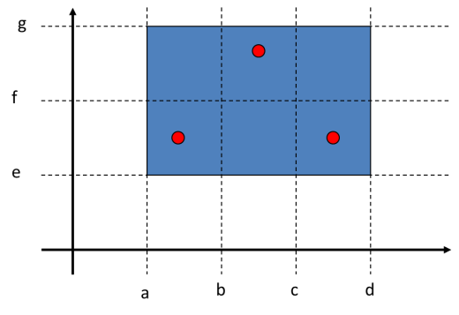

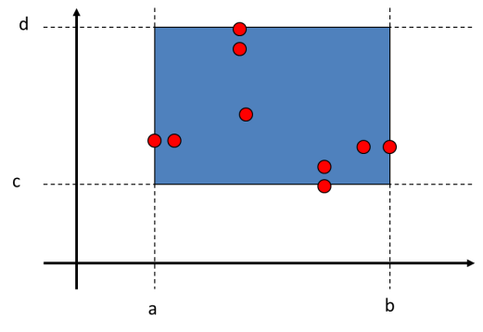
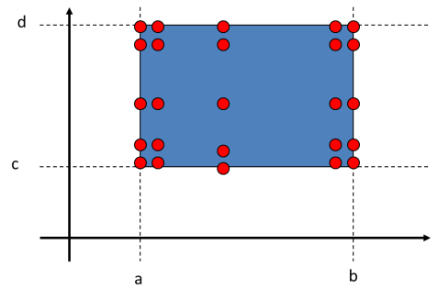


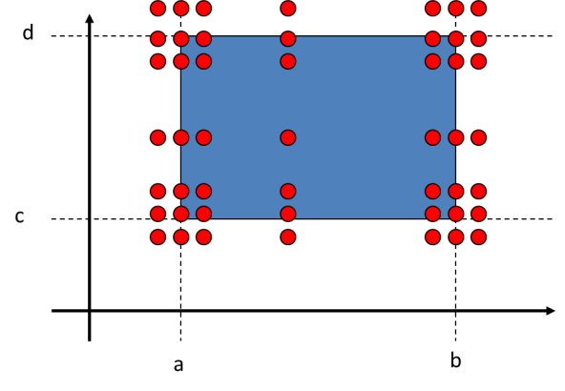
EC & BVA
BVA
Weak Normal
Weak Robust
Worst Case Analysis
Strong Normal
Strong Robust

Slide 12
Process for Test Case Creation
Create a table with valid and in-valid subdomains
Number the rows
Based on the focus (WN, SN, WR, SR of EC) pick the combination of the rows (valid and in-valid subdomains)
Choose a value and outcome which will form a test case
Repeat any or all steps to arrive at coverage and completeness required for the problem

Slide 13
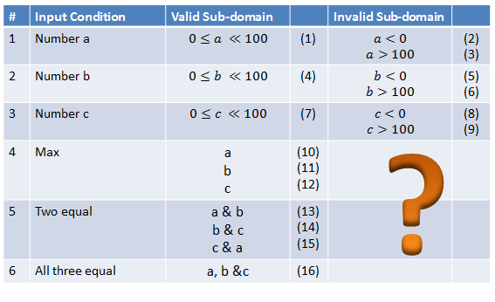
Example – Max of 3 numbers

Slide 14
Examples - discuss
Discuss various test cases and design approaches
What types of faults are anticipated?
Are the requirements sufficient?
Any assumptions made? How were the assumptions made?
It is recommended that code should be written for both to understand the problem better.

Slide 15
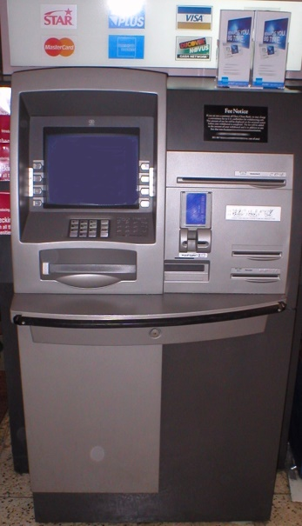
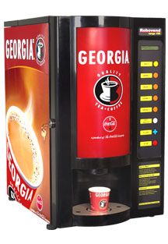
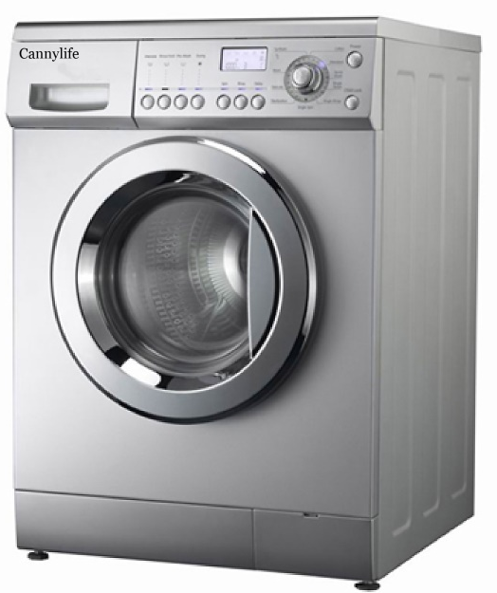
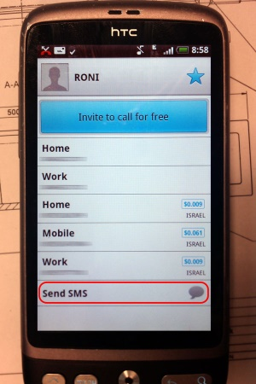
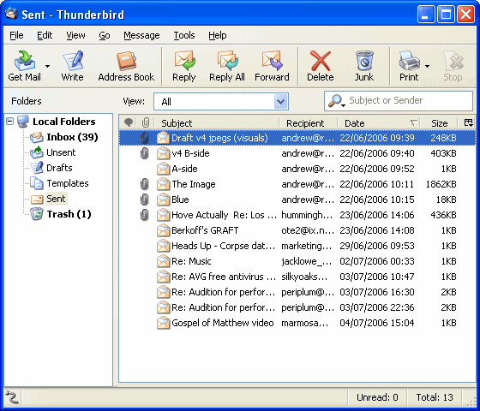
Examples
Automated Teller Machine
Tea/Coffee Vending Machine
Washing Machine
Contacts – Mobile Phone Application
Messaging – Mobile Phone Application
Email – Webmail/App/Client
…

Slide 16
Software Testing Methodologies
Prashant Joshi

